Slide 1

SQL Project
on
AtliQ CONSUMER AD-HOC INSIGHTS
- Suraj Kant

Slide 2
Table of Contents
Company’s Overview and Market
Objectives
Problem Statement
Project Overview
Report
Conclusion
2

Slide 3
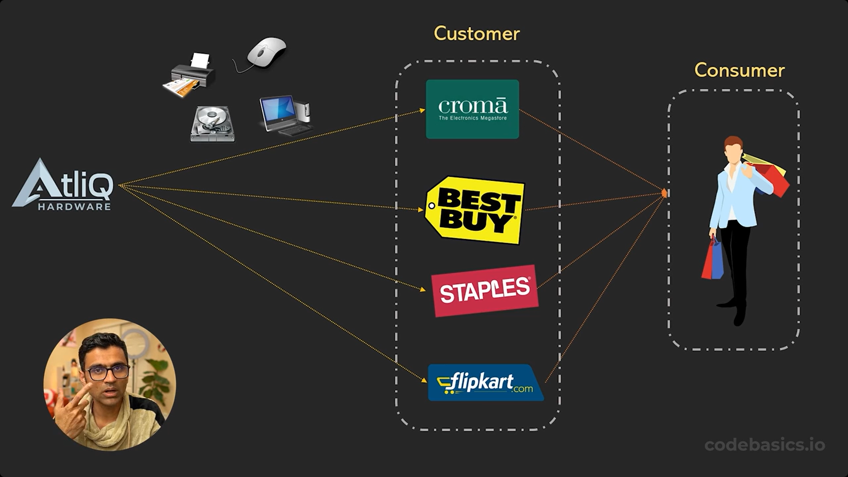

Company’s Overview and Market
AtliQ Hardware is a distinguished global leader in electronics manufacturing, specializing in the production and distribution of an extensive range of high-quality hardware products.
The company manufactures products under 3 major divisions i.e., Netorking & Storage, PC, Peripherals & Accessories, serving the diverse needs of customers worldwide.
AtliQ Hardware is operational in NA, LATAM, EU and APAC regions.
3

Slide 4
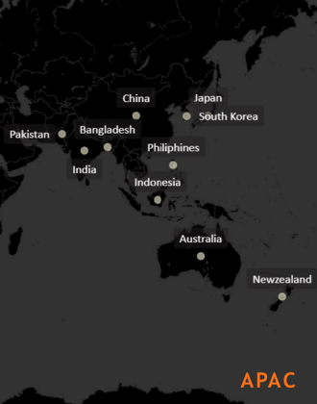

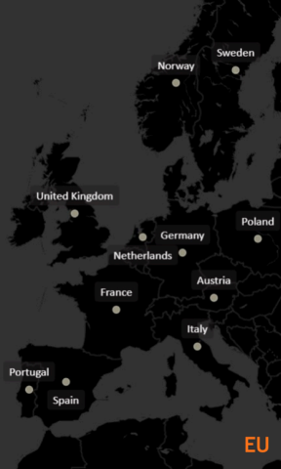
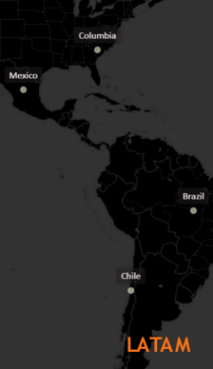
Company Overview and Market
AtliQ Hardware is operational in APAC, EU, LATAM and NA regions.
4

Slide 5
Objectives
AtliQ Hardware (fictitious corporation) is one of the major computer hardware manufacturers in India, with a strong presence in other nations.
Nevertheless, the management did note that they do not have sufficient insights to make prompt, wise, and data-informed judgments.
Plan to expand the data analytics team by adding junior data analysts.
To assess candidates, Data analytics director, Tony Sharma plans to conduct a SQL Challenge to evaluate both tech and soft skills.
The company seeks insights for 9 ad hoc requests.
5

Slide 6
Problem Statement
AtliQ Hardware is currently facing performance challenges due to the increasing size and complexity of its Excel files. To address this, the company has formed a dedicated team of data analysts to leverage MySQL for extracting valuable insights and enhancing operational efficiency.
6

Slide 7
Project Overview
The Scope of this project entails conduction an in-depth analysis of the dataset provided by AtliQ Hardware. The primary goal is to derive actionable insights regarding sales performance, market dynamics, customer behavior, and to forecast supply chain trends.
7

Slide 8
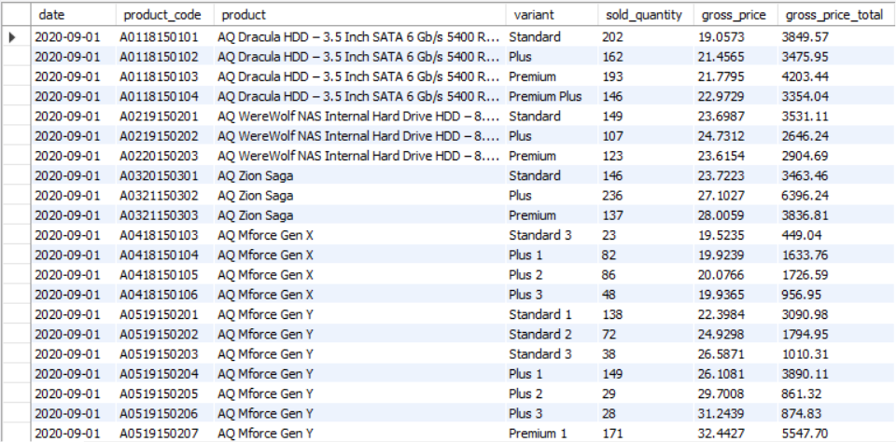
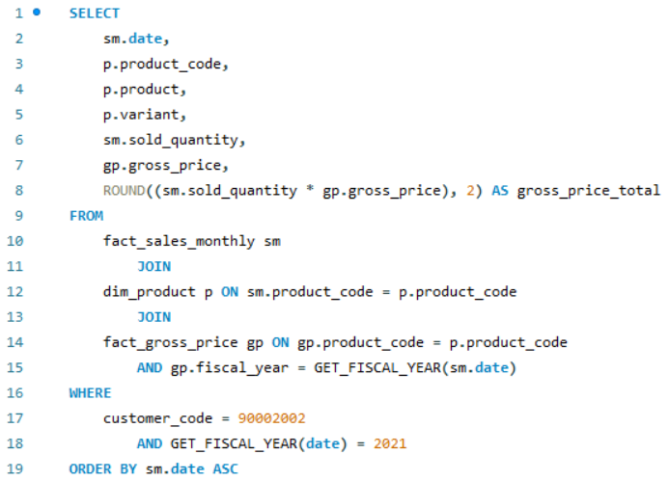
Chroma Sales Report
Generate a report detailing the individual product sales for Croma India customer throughout the fiscal year 2021.
8

Slide 9
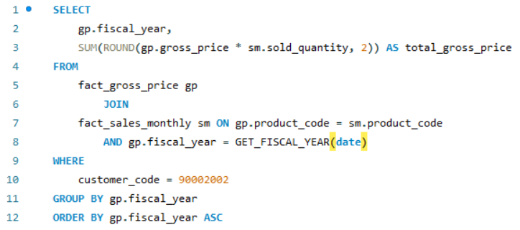
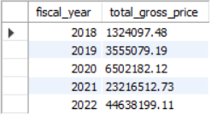
CROMA YEARLY GROSS SALES REPORT
Generate a yearly report for Croma India where there are two columns.
Fiscal Year
Total Gross Sales amount
in that year from Croma.
9

Slide 10
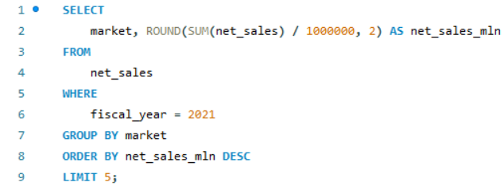
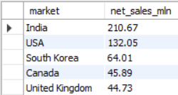
TOP 5 MARKETS
Generate a report getting Top 5 markets
by Net Sales in Fiscal Year 2021
10

Slide 11
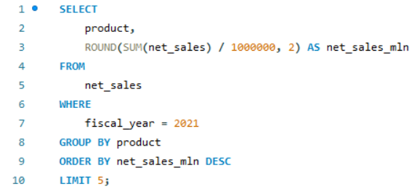
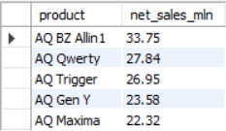
TOP 5 Products
Generate a report getting Top 5 Products by Net Sales in Fiscal Year 2021
11

Slide 12
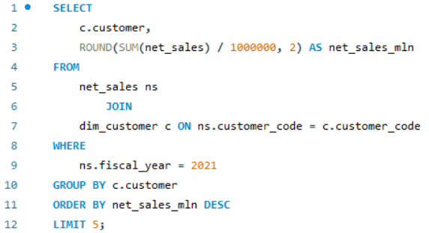
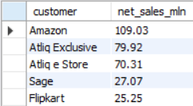
TOP 5 Customers
Generate a report getting Top 5 Customers by Net Sales in Fiscal Year 2021
12

Slide 13
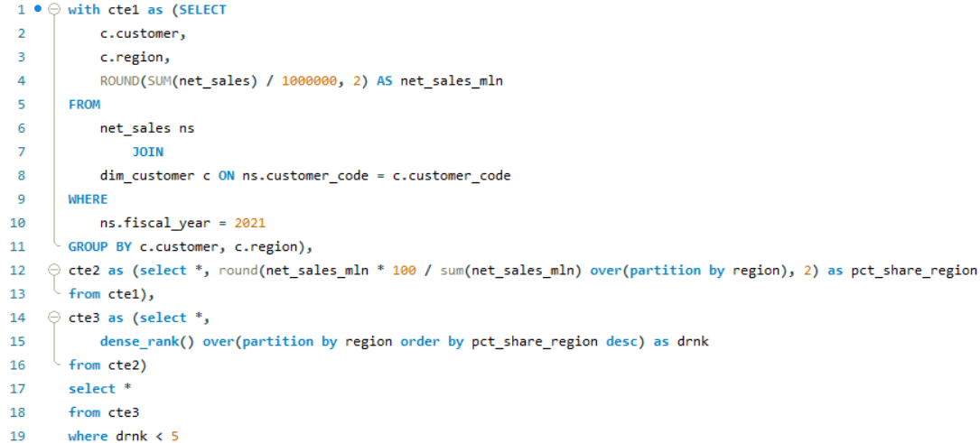
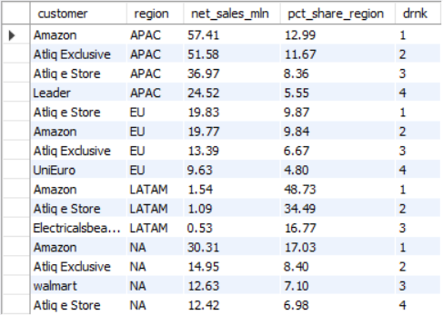
NET SALES % REPORT
Generate a Net Sales% report of Top 4 Customers in different regions
13

Slide 14
Market Share %
Top 10 Customers by market share % in different Regions
14

Slide 15
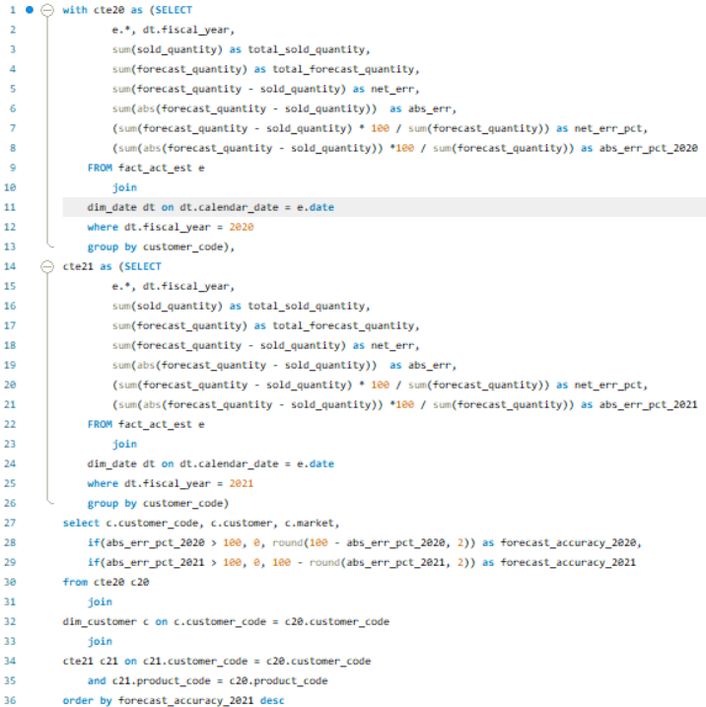
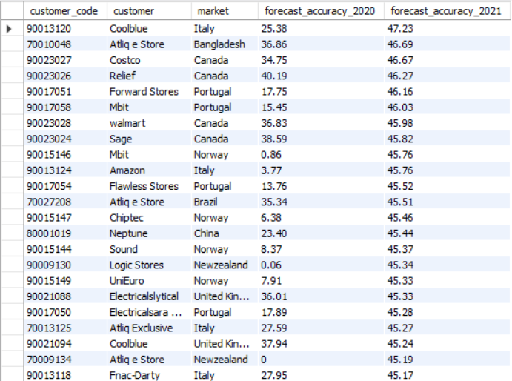
Forecast Accuracy 2020 vs 2021
Generate a report comparing forecast accuracy of 2020 and 2021 by Customer
15

Slide 16
Forecast Accuracy 2020 vs 2021
Forecast Accuracy 2020 vs 2021 by Customer(Top 5 customers by 2021 forecast accuracy)
16

Slide 17
Conclusion
AtliQ Hardware achieved record sales in 2022.
India was the largest market in 2021 with sales of $210.67M.
Amazon generated the highest Net Sales in 2021 with $109.03M.
The AQ BZ All-in-One was the top-selling product in 2021 with the sales of $33.75M.
Amazon captures the top market share% in APAC, LATAM & NA regions.
AtliQ e-store topped the chart in EU region.
For year 2021 the forecast accuracy is much more accurate than 2020 for each customer.
17

Slide 18
Thank You!

